Slide 1
Practice Lab:
This Practice Lab has as a prerequisite, Practice Lab 6241, where we install and configure Eclipse Photon on MacOS including a Scala plugin.
This Practice Lab also has a prerequisite, Discussion Units 7544/7545 and 7548/7549, where we make the DSE Analytics client we run here.
In this Practice Lab, we edit, compile, and run a DSE Analytics client program. As such, this lab expects an operating DSE cluster with DSE Analytics be accessible.
Instructions in this practice lab are written for MacOS, but should function for most Linux distros.
This Practice Lab will require reasonable Internet access.
Edit and Compile using Eclipse with Scala
Notes:
The goal of this Practice Lab is to compile and run a DSE Analytics client.
Prerequisites/other include:
This Practice Lab has as a prerequisite, Practice Lab 6241, where we install and configure Eclipse Photon on MacOS including a Scala plugin.
This Practice Lab also has a prerequisite, Discussion Units 7544/7545 and 7548/7549, where we make the DSE Analytics client we run here.
In this Practice Lab we edit, compile, and run a DSE Analytics client program. As such, this lab expects an operating DSE cluster with DSE Analytics be accessible.
Instructions in this practice lab are written for MacOS, but should function for most Linux distributions.
This Practice Lab will require reasonable Internet access.

Slide 2

Eclipse IDE: What is it ?
Open source integrated developer's workbench (IDE)
From 1984's Visual Age, a similar IBM program
Not apache, is Eclipse Public License (ECL)
Releases with science related names
June/2018 release is Photon
Many/many development languages supported
Extensible (Vi plugin !)
Notes:
What is Eclipse-
Reference Urls,
https://en.wikipedia.org/wiki/Eclipse_(software)
https://en.wikipedia.org/wiki/IBM_VisualAge

Slide 3

Eclipse: How to Install
Reference Practice Lab 6241, where we installed Eclipse, and an Eclipse plugin specific to Scala.
Launch Eclipse, and then ..
Instructions in Practice Lab 6241.
Notes:
Install and configure Eclipse Photon, per the instructions detailed in Practice Lab 6241.

Slide 4
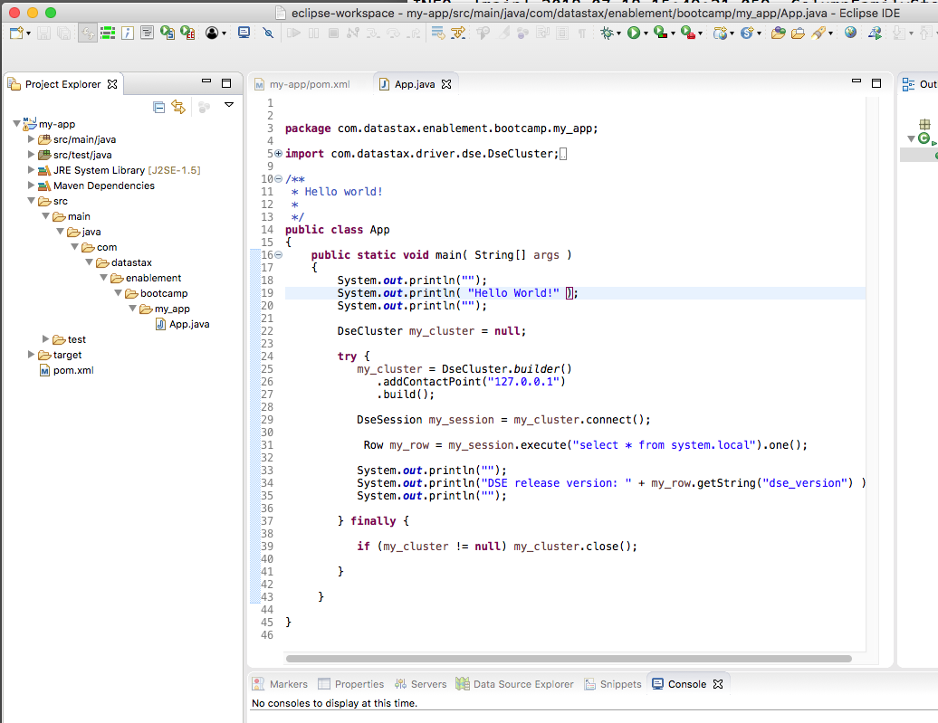
After Practice Lab 6241-
Configured for DSE Java clients
Eclipse Scala plugin installed
Notes:
After a complete execution of Practice Lab 6241, we have a Maven project to support a DSE Java client. This project displays as shown in the Eclipse Project Explorer view.

Slide 5
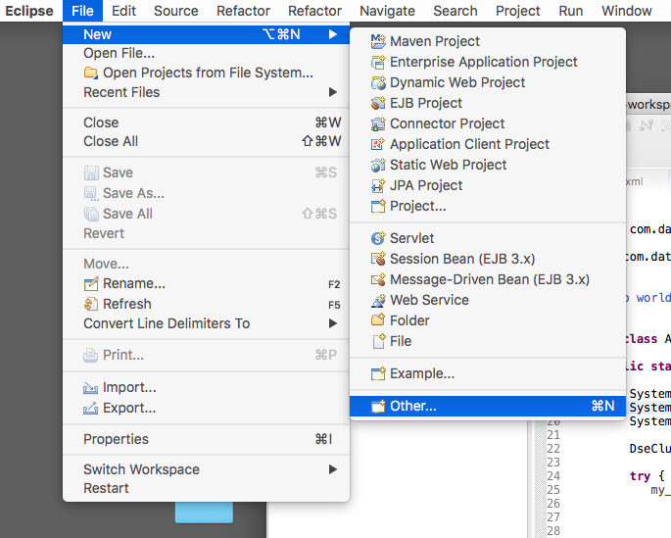
From the Eclipse Menu Bar-
File -> New -> Other
Notes:
Now we need to make a new project; one to support Scala. (An Eclipse project will either support compilation of Java, or Scala; not both at the same time.)
From the Eclipse Menu Bar, select; File -> New -> Other

Slide 6
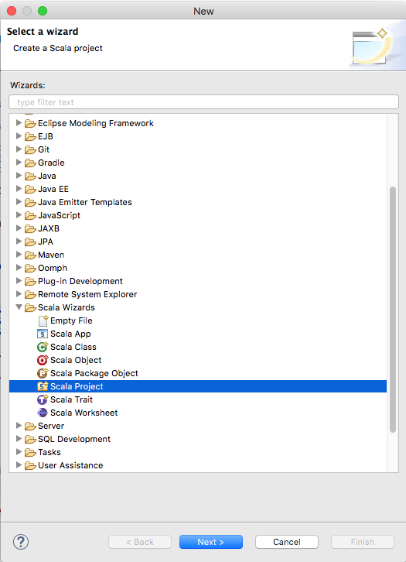
Don't use this-
Simple Scala programs only
Not a Maven project, no pom.xml
Better off using the DSE Spark REPL
Notes:
While tempting, the path to, Scala Wizards -> Scala Project, will not work for us; this type of project does not use Maven, has no pom.xml, other.
This type of project would support simpler Scala programs only.

Slide 7
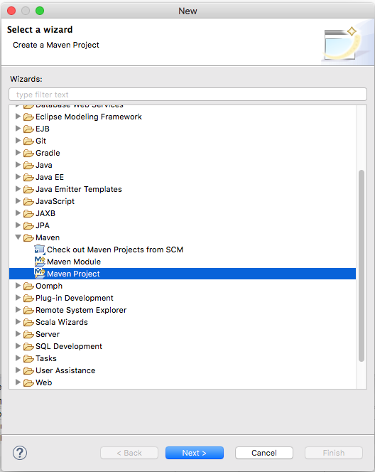
In the, Select a wizard, modal dialog box
Maven -> Maven Project
This option gives us support for a pom.xml, which will automatically pull all of our (DSE and Spark) dependencies
Notes:
In the modal dialog box titled, Select a wizard, select; Maven -> Maven Project
Maven is capable enough to configure for a DSE Analytics (Apache Spark) client on its own.

Slide 8
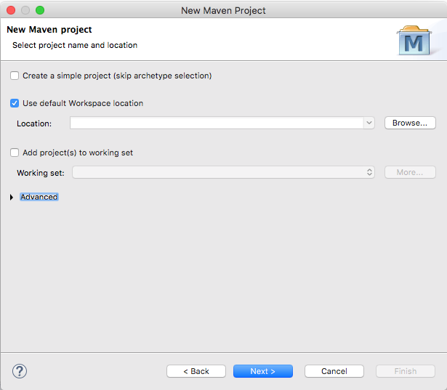
Just click through this dialog box-
There's nothing we need on this dialog box-
Click, Next
Notes:
We don't need any of the function from this dialog box; just click, Next.

Slide 9
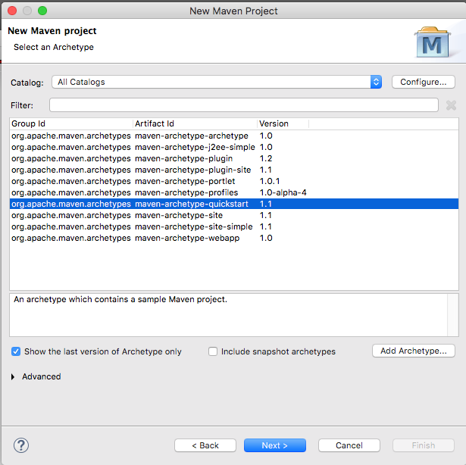
Maven Archetypes
Maven Archetypes, a project templating device; filesystem structure, other
The default is the same we used in Discussion Unit 6240, the default Java client archetype
We want Scala
Click, Configure
Notes:
Maven archetypes are essentially project templates, and call to create a standard filesystem structure, make given compiler and other settings, and more.
The default archetype that comes up is the same we used on Discussion Unit 6240, where we edited, compiled, and run a DSE Java client.
We want a DSE Analytics (Apache Spark) client today, and will need to configure for an online archetype repository. (Eclipse Photon ships with zero Scala archetypes.)
Click, Configure

Slide 10
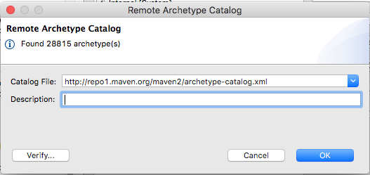
Online (Remote) Maven Archetype Repository
Enter the value as shown in the text entry field titled, Catalog File
Optionally Click, Verify
And Click, OK
Notes:
We need to configure to use the standard Maven online repository for archetypes; example as shown.
Enter, http://repo1.maven.org/maven2/archetype-catalog.xml, in the text entry field titled, Catalog File, then TAB to the next visual control.
Optionally click, Verify.
Then click, OK.

Slide 11
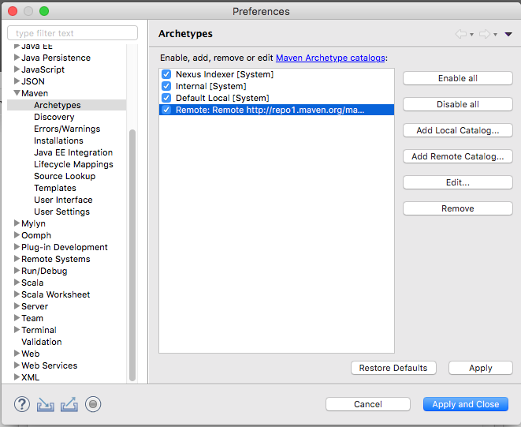
Archetype Catalog added-
After the addition of our Archetype Catalog, Click, Apply and Close
Notes:
After the addition of our Archetype Catalog, click, Apply and Close.

Slide 12
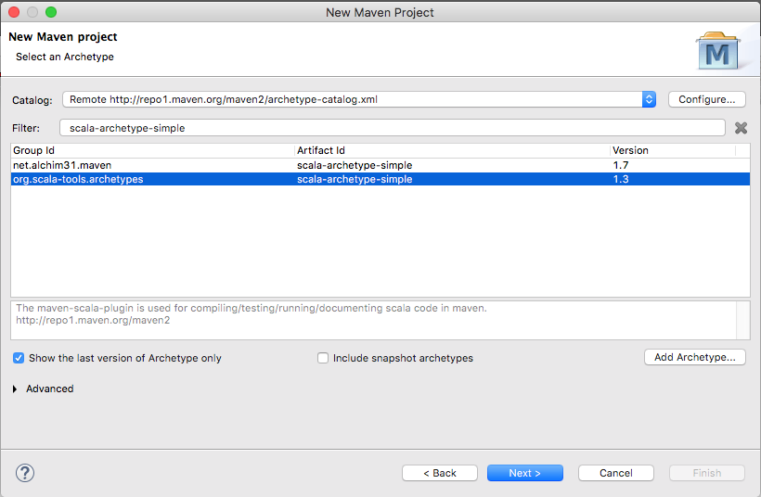
Picking a given Archetype
Manage the display as shown on the right-
Specifically enter a Filter of, scala-archetype-simple, to reduce the number of options
When your dialog box matches that as shown, Click, Next
Notes:
At this point we are pointing to a Maven Archetype Catalog with way too many entries. (Maven can manage development of Java, Scala, Ruby, and many more languages and project types. Too many, perhaps.)
Enter a Filter value of, scala-archetype-simple, the similar value to what we used in Discussion Unit, 7548.
Later, we wont use either of the two available GroupId's, since we need DSE specific settings neither know about. For now, however, select the version 1.3 option, and click, Next. (GroupId in this context represents the archetype setting. On the next page, GroupID has a different context.)

Slide 13
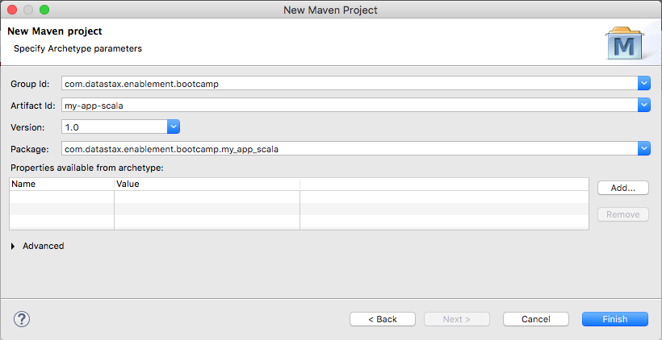
The Project Proper-
Enter a GroupId, ArtifactId, and Version as shown
Click, Finish
Notes:
Perform the following:
Enter a GroupId as shown. The GroupId value is the same as our package statement, inside our soon to be generated App.scala source code file.
Enter an ArtifactId as shown. This value is the same as our (Scala) project name.
And enter a Version as shown. As a first/simple program, the value, 1.0, is simple to type and use.
And click, Finish.

Slide 14
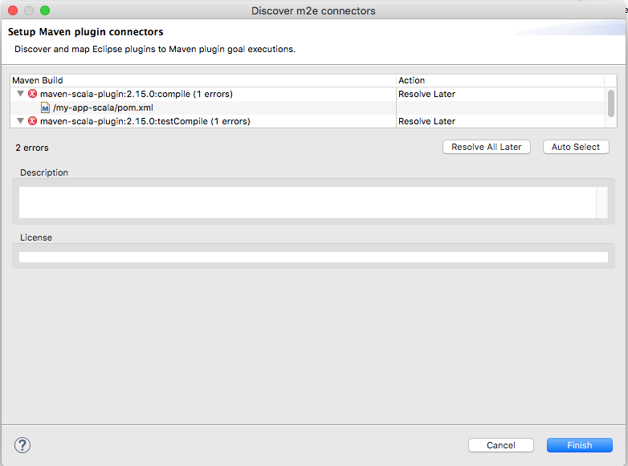
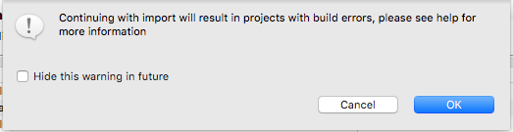
As generated, a number of things are broken-
We'll fix these; not here
Notes:
As a generated project, a number of things are broken like Java Virtual Machine version, other.
We'll fix these on the screens that follow.
For now, click through; Finish, OK, (possibly others).

Slide 15
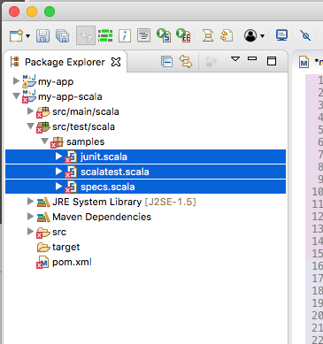
Delete the generated/stub, test code
In the Project Explorer view, navigate to, my-app/scala -> src/test/scala -> samples
Shift-Click all entries, Right-Click, and Delete
These are stub test units and do not compile
Notes:
Maven generated a number of stubbed out test units that will not compile; delete using the steps outlined above.
This condition, and repair, is the same as we performed in Discussion Unit 7548; same cause, same effect, same repair.

Slide 16
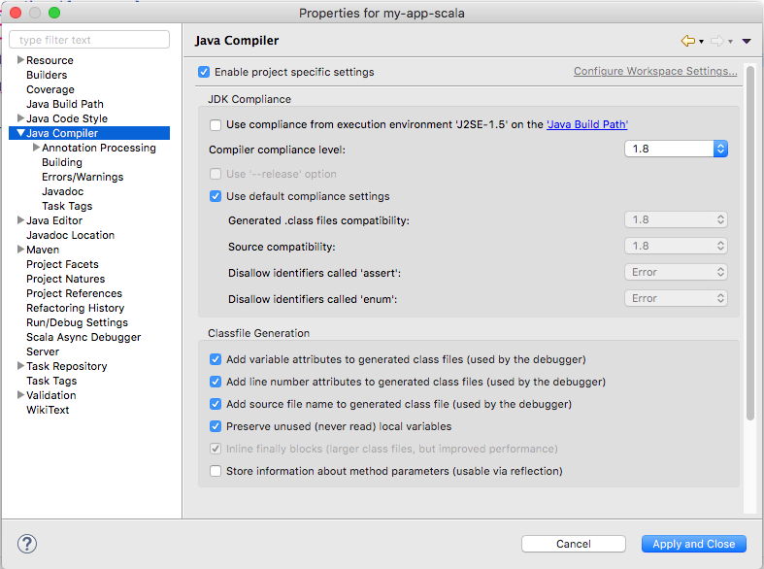
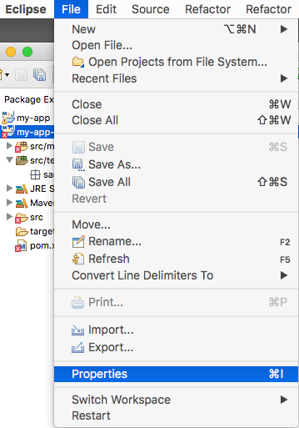

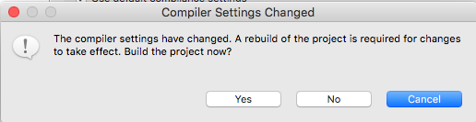
Setting Java Compiler version to 1.8-
Notes:
We need to configure to use the Java Compiler version 1.8; initially it is set to version 1.5, the default JDK/JRE for Eclipse Photon.
From the Eclipse Menu Bar, select; File -> Properties -> Java Compiler
Un-check, "Use compliance ..", and manage the display to select a version 1.8 Java compiler.
Click, Apply and Close.
Upon changing the compiler settings, the modal dialog box as displayed is produced, click, Yes.

Slide 17
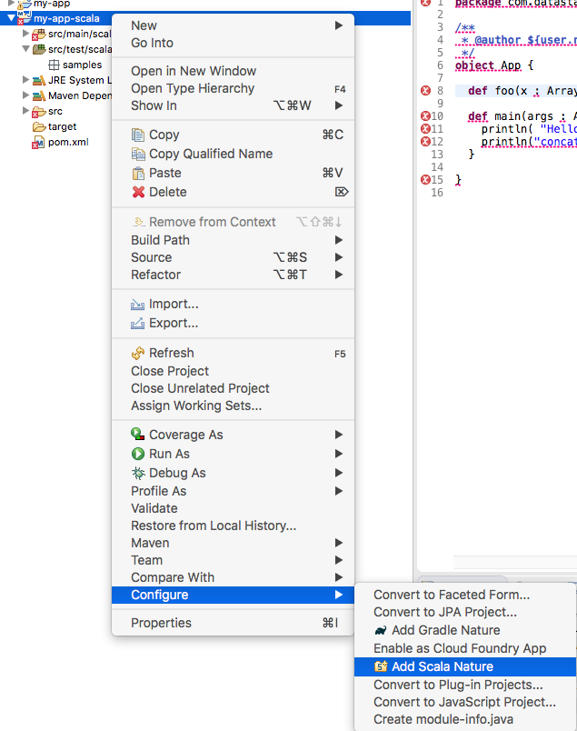
Maven knows, Eclipse doesn't know
While Maven knows we want a Scala project, Eclipse does not
In the Project Explorer view, Right-Click the project, and select; Configure -> Add Scala Nature
Notes:
While Maven was asked to generate a (Maven) Scala project, Eclipse has yet to receive this news.
Complete the following:
In the Eclipse Project Explorer view, Right-Click the project (my-app-scala), and select; Configure -> Add Scala Nature

Slide 18
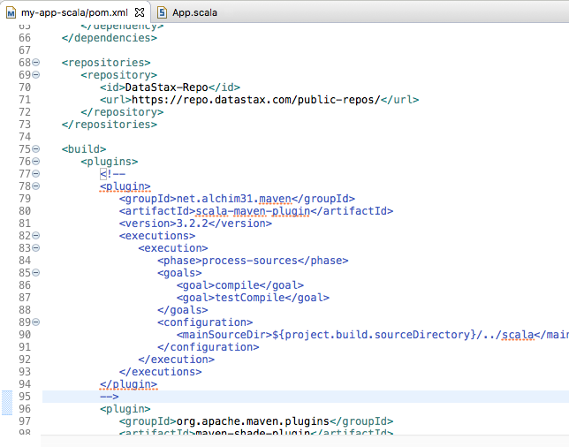
Fix the pom.xml-
Edit the pom.xml file as detailed on the Notes page.
Save
From the Menu Bar; Project -> Clean
(Clean can take a bit of time.)
Notes:
The Maven archetype we chose served our needs until now.
There is no archetype in the standard online Maven repository that knows how to compile the exact version of DSE Analytics (Apache Spark) client we want; thus, we'll have to edit the pom.xml.
For now, an interim step, we want to remove one of the plugins from the pom.xml. Complete the following:
In the Eclipse Project Explorer view, navigate to the pom.xml (there is only one per project), and Double-Click to open this file in the Editor view.
We want to comment out (or delete) the entire plugin block for net.alchim31.maven
Multi-line comments in XML begin with a, <!- - (no spaces between those 4 characters).
And end with a, - -> (no spaces between those 3 characters).
Right-Click the pom.xml file again, and choose, Save.
From the Eclipse Menu Bar, select; Project -> Clean
Clean can take a bit of time to complete; be patient.

Slide 19
What is a pom.xml ?
<project xmlns="http://maven.apache.or ...
xsi:schemaLocation="http://mav ...
<modelVersion>4.0.0</modelVersion>
<groupId>com.datastax.enablement.bootcamp</groupId>
<artifactId>my-app</artifactId>
<packaging>jar</packaging>
<version>1.0-SNAPSHOT</version>
<name>my-app</name>
<url>http://maven.apache.org</url>
<dependencies>
<dependency>
<groupId>junit</groupId>
<artifactId>junit</artifactId>
<version>3.8.1</version>
<scope>test</scope>
</dependency>
</dependencies>
</project>
xml
"project object model"
Each project has one
Tells Maven how to compile, etc, your project
Edit once and done ?
Notes:
The contents of pom.xml are displayed. Comments:
While XML formatted, the (syntax of a POM) is far reaching, and can become complex for true enterprise projects.
In this unit, we cover most aspects of a POM relative to compiling DSE Analytics (Apache Spark) client programs.

Slide 20
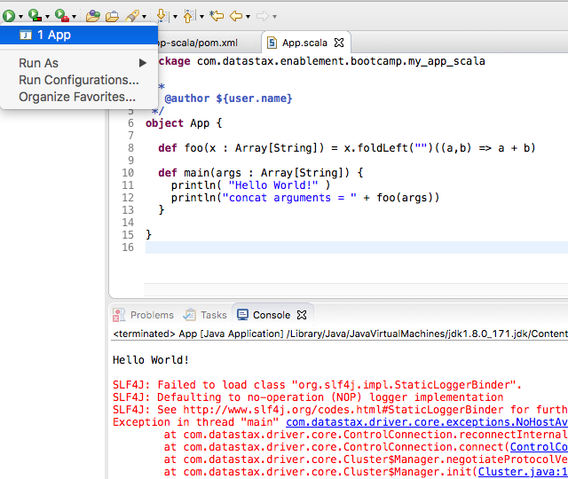
Run the generated App.scala
Time for a test-
In the Project Explorer view, find and open (Double-Click) App.scala
From the Eclipse Toolbar, click the Run icon (Run is context sensitive, and App.scala must be current.)
Successful output as shown in the Console view
Notes:
Time for a test; have we done everything correctly thus far ?
Complete the following:
The Maven generated App.scala should run and output as shown in the Eclipse Console view.
In the Eclipse Project Explorer view, find and open (Double-Click) the App.scala program
The Eclipse Toolbar is context sensitive, be certain App.scala is open and current.
In the Toolbar, find the (single green arrow; it has a balloon help titled, Run).
Click; Run -> App
You should receive the output as shown in the Console view.

Slide 21
That was the default generated App.scala-
From Discussion Unit 7548/7549, and 7554, grab the very same pom.xml, and App.scala you created and ran there.
Copy and paste the above files into the same pom.xml and App.scala you just generated and ran. Be certain to Save.
Do a, Project -> Clean, and Run
Notes:
Also in the Eclipse Console view is an error; the generated App.scala doesn't know how to find the DSE Analytics server.
Complete the following:
From Discussion Unit 7548/7549, grab the very same pom.xml, and App.scala you created and ran there.
Copy and paste the above files into the same pom.xml and App.scala you just generated and ran.
Be certain to Save.
Do a, Project -> Clean, and Run
Output in the Console view should be similar to that as displayed on the next page.

Slide 22
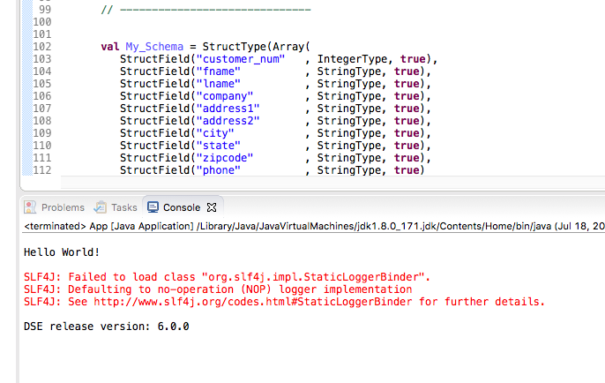

You are done when-
Notes:
You are done when:
You successfully compile and run your program from Discussion Unit 7548/7549.

Slide 23

Practice Lab:
Lessons Learned
Notes:
Discuss what worked well, poorly, from the Practice Lab.

Slide 24
End of Unit:
Notes:
End of Practice Lab-

Slide 25
Additional Detail:
Notes:
The remaining content may be read “extra credit”, as time allows.

Slide 26
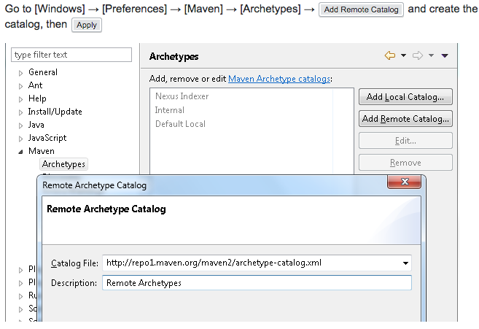
More Help Finding Archetypes:
The Notes page lists a Url to a StackOverflow article on finding Maven Scala archetypes-
Notes:
Reference Urls:
https://stackoverflow.com/questions/29114936/how-do-i-find-the-correct-maven-archetype-project-for-developing-with-scala-in-e

Slide 27
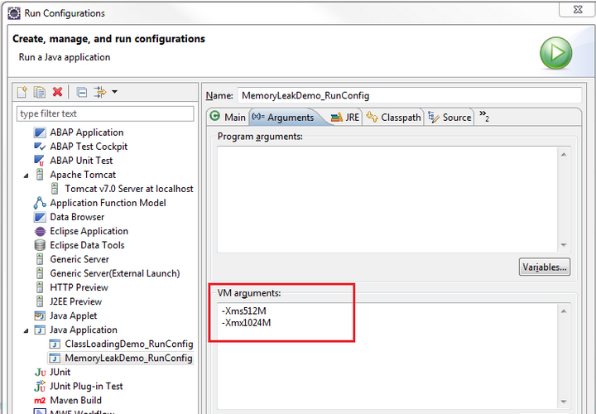
Eclipse Sluggish ?
Eclipse is a Java app
Tune the JVM settings as shown; specifically Xmx
1G default is common, 4G if you have room
Url on Notes page
Notes:
Reference Urls:
http://www.planetofbits.com/eclipse/increase-jvm-heap-size-in-eclipse/

